Slide 1

Tutorial 2: NoSQL & Spark
Nicholas Lim
e0045287@u.nus.edu

Slide 2
Question 1a
MapReduce and the Google File System (GFS) were designed to work well together. What important optimization in MapReduce is enabled by having GFS expose block replica locations via an API?

Slide 3



Solution 1a
The MapReduce scheduler can arrange for Map tasks to execute on the same node that stores the data, avoiding a copy across the network.
$$D_{1}$$
$$D_{3}$$
$$D_{2}$$

Slide 4
Question 1b
List two features that are originally designed for relational databases and are now integrated into the MapReduce/Hadoop software stack.
High-level languages
Column stores

Slide 5
Question 2a
What are the advantages of using schema in Spark?
Consistency. Applying schema omits the need to infer the data types from the table or DataFrame which may not be correct.
Schemas define a contract for data, providing the same logical views of tables on different systems.

Slide 6
Question 2b
List three of the many common development features or considerations between relational databases and Spark.
schema
query optimization
high level languages

Slide 7
Question 2c
In HDFS, each chunk is replicated for three times by default. In contrast, in Spark, RDD uses lineage for reliability. What is a major problem if Spark also uses replications for reliability?
Consumes a lot of memory

Slide 8
Question 2d
Is it true that in the Spark runtime, RDD cannot reside in the hard disk?
False. RDD can also be in the disk if out of memory.

Slide 9
Question 3
NoSQL databases have been a hot research topic.
The following questions relate to the trade-offs between relational and NoSQL systems. A more detailed discussion can be found in this paper (not required reading for the class, but still a useful summary if you are interested):
Rick Cattell. 2011. Scalable SQL and NoSQL data stores. SIGMOD Rec. 39, 4 (May 2011), 12-27.

Slide 10
Question 3a
Compare ACID and BASE. Why do NoSQL systems choose BASE?
ACID = Atomicity, Consistency, Isolation, and Durability
BASE = Basically Available, Soft state, Eventually consistent

Slide 11
Solution 3a
Atomicity: Each transaction is "all or nothing” (i.e. succeed completely or fail completely).
Consistency: Any transaction will bring the database from one valid state to another.
Isolation: Ensures that concurrent execution of transactions leaves the database in the same state that would have been obtained if the transactions were executed sequentially.
Durability: Once a transaction has been completed, it will remain so, even in the event of power loss, crashes, or errors.

Slide 12
Solution 3a
Basically Available: Reading and writing operations are available as much as possible, but without consistency guarantees (e.g. read may not get the latest updated value).
Soft state: The state of the system is always ‘soft’ or changing with inputs, until it reaches ‘eventual consistency’.
Eventually consistent: The system will eventually become consistent (e.g. multiple reads eventually return the same value).

Slide 13
Solution 3a
The idea is that by giving up ACID constraints, one can improve performance.

Slide 14
Question 3b
Why do we need specialized engines (e.g. document stores) in NoSQL systems, as compared to relational databases?
Performance and flexibility.

Slide 15
Question 3c
What is a practical reason to prefer horizonal scalability over vertical scalability?
Less expensive, using commodity servers.

Slide 16
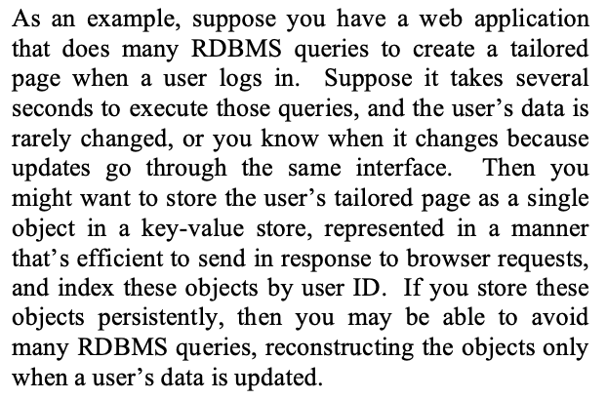
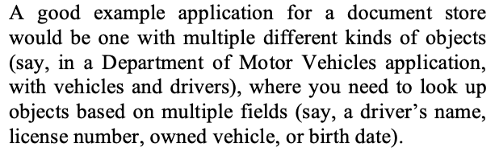
Question 3d
In the mentioned paper, they list a suitable application for key-value stores:
And for document stores:
Discuss some factors that make these applications suitable for key-value stores and document stores respectively.

Slide 17
Question 3d
Key-value store:
Improves scalability and efficiency – writing or reading user pages is faster.
No need for complex queries or based on the content of user pages – just reads and writes.
May be acceptable for user pages to be slightly stale – then eventual consistency is acceptable
Document store:
Flexible schema may be beneficial (e.g. special types of vehicles may require different sets of fields)
Unlike key-value stores, document stores allow for queries based on fields of a document

Slide 18
Acknowledgements
- Zhaomin Wu and Qinbin Li tutorial slides.

